Slide 1
Introduction to Operating System
Presented by: D. Mwekera

Slide 2
Introduction
An operating system acts as an intermediary between the user of a computer and computer hardware.
The purpose of an operating system is to provide an environment in which a user can execute programs in a convenient and efficient manner.
An operating system is a software that manages the computer hardware.
The hardware must provide appropriate mechanisms to ensure the correct operation of the computer system and to prevent user programs from interfering with the proper operation of the system

Slide 3
Operating System – Definition:
An operating system is a program that controls the execution of application programs and acts as an interface between the user of a computer and the computer hardware.
A more common definition is that the operating system is the one program running at all times on the computer (usually called the kernel), with all else being application programs.

Slide 4
Types of Operating System (OS)
Batch Operating System
Multitasking/Time Sharing OS
Multiprocessing OS
Real Time OS
Distributed OS
Network OS
Mobile OS

Slide 5
Batch Operating System
Some computer processes are very lengthy and time-consuming.
To speed the same process, a job with a similar type of needs are batched together and run as a group.
The user of a batch operating system never directly interacts with the computer.
In this type of OS, every user prepares his or her job on an offline device like a punch card and submit it to the computer operator.

Slide 6
Multi-Tasking/Time-sharing Operating systems
Time-sharing operating system enables people located at a different terminal(shell) to use a single computer system at the same time.
The processor time (CPU) which is shared among
multiple users is termed as time sharing.

Slide 7
Real time OS
A real time operating system, the time interval to process and respond to inputs is very small.
Examples:
Military Software Systems,
Space Software Systems are the Real time OS example.

Slide 8
Distributed Operating System
A distributed system is a collection of computer programs that utilize computational resources across multiple, separate computation nodes to achieve a common, shared goal.
Also known as distributed computing or distributed databases.
It relies on separate nodes to communicate and synchronize over a common network.

Slide 9
Network Operating System
Network Operating System runs on a server.
It provides the capability to server to manage data, user, groups, security, application, and other networking functions
Examples of N.O.S. include:
UNIX, Linux, Microsoft Windows Server 2012, Microsoft Windows Server 2008, Microsoft Windows Server 2003, Novell NetWare, Banyan's VINES, Artisoft's LANtastic, Mac OS X, and BSD.

Slide 10
Mobile OS
Mobile operating systems are those OS which are specifically designed to power smartphones, tablets, and wearables devices.
Some most famous mobile operating systems are Android and iOS,
Others include:
BlackBerry, Web, and watch-OS.

Slide 11
An operating system is concerned with the allocation of resources and services, such as memory, processors, devices, and information.
The operating system correspondingly includes programs to manage these resources, such as:
-a traffic controller,
-a scheduler,
-memory management module,
-I/O programs, and a file system.

Slide 12
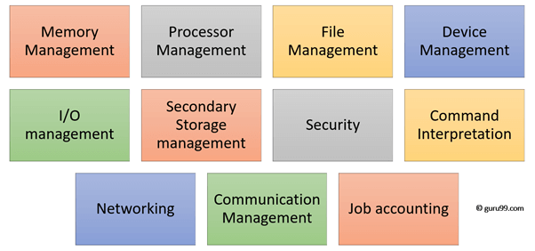
Functions of Operating system

Slide 13
Functions of OS
Process management:- Process management helps OS to create and delete processes.
It also provides mechanisms for synchronization and communication among processes.
Memory management:- Memory management module performs the task of allocation and de-allocation of memory space to programs in need of this resources.
File management:- It manages all the file-related activities such as organization storage, retrieval, naming, sharing, and protection of files.

Slide 14
Functions of OS cont.…/
Device Management: Device management keeps tracks of all devices. This module also responsible for this task is known as the I/O controller.
It also performs the task of allocation and de-allocation of the devices.
I/O System Management: One of the main objects of any OS is to hide the peculiarities of that hardware devices from the user.

Slide 15
Functions of OS cont.…/
Secondary-Storage Management: Systems have several levels of storage which includes primary storage, secondary storage, and cache storage.
Instructions and data must be stored in primary storage or cache so that a running program can reference it.
Security:- Security module protects the data and information of a computer system against malware threat and authorized access.
Command interpretation: This module is interpreting commands given by the and acting system resources to process that commands.

Slide 16
Functions of OS cont.…/
Networking: A distributed system is a group of processors which do not share memory, hardware devices, or a clock.
The processors communicate with one another through the network.
Job accounting: Keeping track of time & resource used by various job and users.
Communication management: Coordination and assignment of compilers, interpreters, and another software resource of the various users of the computer systems

Slide 17
Functions of OS cont…/
Functions and characteristic of a good OS:
Convenience: An OS makes a computer more convenient to use.
Efficiency: An OS allows the computer system resources to be used in an efficient manner.
Ability to Evolve: An OS should be constructed in such a way as to permit the effective development, testing and introduction of new system functions at the same time without interfering with service.

Slide 18
Operating system as User Interface –
User
System and application programs
Operating system
Hardware

Slide 19
Every general-purpose computer consists of the hardware, operating system, system programs, and application programs.
The hardware consists of memory, CPU, ALU, and I/O devices, peripheral device, and storage device.
System program consists of compilers, loaders, editors, OS, etc.
The application program consists of business programs, database programs.

Slide 20
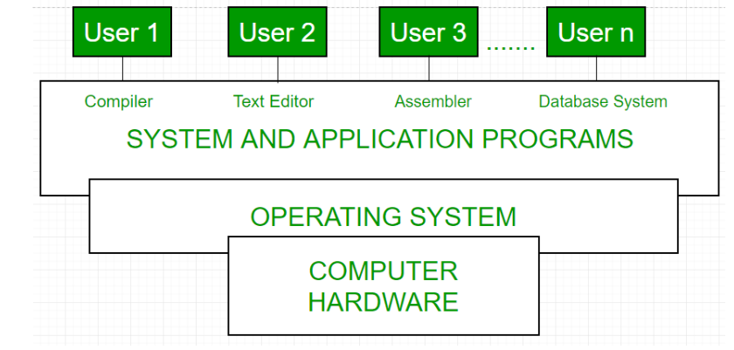
Conceptual view of a computer system

Slide 21
THE END OF PRESENTATION
THANK YOU FOR BEING ATTENTIVE

